Slide 1

Mobile detection with CupCarbon
Batch No: A-01 Project Guide:
S. Farhana [164G1A0525] Mr. T. Venkata Naga Jayudu, M.Tech., (Ph.D)
P. Harshitha [164G1A0529] Assistant Professor
M.Mallika [164G1A0550]
C.Jaya Prakash [174G5A0502]
Srinivasa Ramanujan Institute of Technology
Department of Computer Science & Engineering

Slide 2
Contents
Abstract
Introduction
Existing System
Problem Statement
Proposed System
Requirements
Design
Implementation
Execution
Results
References
Queries??

Slide 3
Abstract
CupCarbon is a Smart City and Internet of things Wireless Sensor Network (SCI-WSN) simulator. Its objective is to design, visualize, debug and validate distributed algorithms for monitoring, environmental data collection, etc.,
The main scope of project is to sense the presence of an activated mobile phones to prevent the use of same in the Restricted Areas.
In the above mentioned conditions a sensor node is placed in the network . Whenever a mobile phone passes through sensor nodes these sensor nodes detect the mobile and send the signal to the sink.

Slide 4
Introduction
Wireless sensor network (WSN) refers to a group of spatially dispersed and dedicated sensors for monitoring and recording the physical conditions of the environment and organizing the collected data at a central location.
CupCarbon is a smart city and IoT wireless sensor network (WSN) simulator. It is a new platform for 2D/3D design, visualization and the simulation of radio propagation and interferences in IoT networks.
Some application fields include tracking, monitoring, surveillance, building automation, military applications, and agriculture, among others. CupCarbon Applications are Smart city, Environmental Protection and sustainable resources, Smart home, Smart water

Slide 5
Existing System
A case study on all the existing wireless sensor network by Cristina López-Pavón, Sandra Sendra1, Juan F. Valenzuela-Valdés which describes the difference between all the WSN like NS-2,omnet++ etc.,[1]
Application of mobile detection by using iot presented by K.Parvateesam , G.A. ArunKumar where a iot device detect the mobile whenever the mobile is in the range.[2]
Application of emergency detection by using cupcarbon by Massinissa Saoudi, Ahc`ene Bounceur, Reinhardt Euler, Tahar Kechadi, Alfredo Cuzzocrea .In which the main aspect is to detect the forest fire by using data mining techniques.[3]

Slide 6
Problem Statement
In our day to day life the usage of mobile phones has been increased In restricted area such as exam venues, Temples etc., This system will be used to detect the mobile phones present in a room by the radio frequency signals which are transmitted by them by using CupCarbon wireless sensor network.

Slide 7
Proposed System
The Proposed Mobile detection system overcome most of the drawbacks that are defined above.
Here it detect the mobiles in the network, it can extend range, it can detect the moving mobiles, it uses graphical interface for real world purpose.
CupCarbon is provided with map in that map create nodes and perform the detection.
After Detection of mobiles the message has to be sent to the sink. And the overall Simulation is done in Graphical User Interface.

Slide 8
Requirements
Hardware Requirements
Processor: Intel i3
Ram : 4GB
Hard Disk : 1TB
Software Requirements
Operating System : Windows 10, Mac
Coding Language : Senscript ,Java
Software: CupCarbon

Slide 9
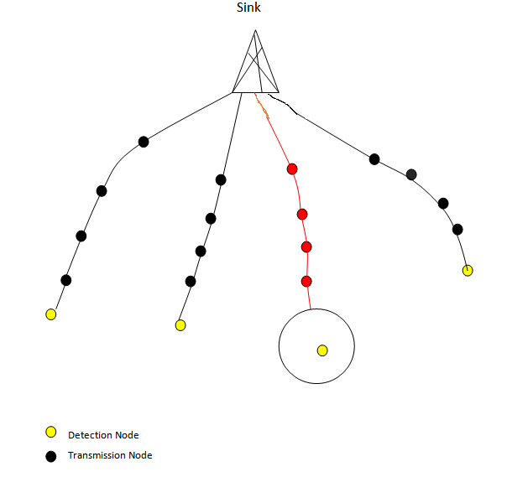
Design
Network Architecture
Networks in Cupcarbon can be designed and prototyped by an ergonomic and easy to use interface using the Open Street Map (OSM) framework to deploy sensors directly on the map.
It includes a script called SenScript which allows to program and to conﬁgure each sensor node individually.

Slide 10
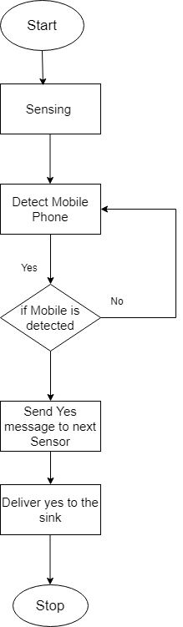
Flowchart

Slide 11
Implementation
Mobile Detection
Here there are mainly the 3 types of nodes are Detection nodes, Transfer nodes and sink.
The work of respective nodes is, for Detection Node to detect the mobile and send it to the transfer node.
Transfer Node is to transfer the data to either sink or another transfer node and finally sink receives the Message through the Transfer node that the mobile is detected.

Slide 12
Contd…
Detection algorithm:
Step 1: Repeat
Step 2: dreadsensor x
Step 3: if x =1
Step 4: send msg to next sensor
Step 5: delay
Step 6: else
Step 7: goto step 1

Slide 13
Contd…
Transmission algorithm:
Step 1: Repeat
Step 2: wait
Step 3: read x
Step 4: send x to next node

Slide 14
Contd..
Sink Algorithm:
Step 1: Repeat
Step 2: wait
Step 3: read x
Step 4: if x=1
Step 5: Blink the node
Step 6: end

Slide 15
Contd…
Energy Consumption
Once the network is ready, the simulation parameters must be speciﬁed: the simulation time and the simulation step.
The curves representing the energy diagrams obtained for each sensor can be viewed in graphs in Graph Viewer.
From these graphs we come to know the how much energy is consumed by each node and also the Battery level of each node.
The Graphs can be Viewed only after the Simulation Process.
The energy Consumption of node can be Calculated
ETotal = ETX + ERX

Slide 16
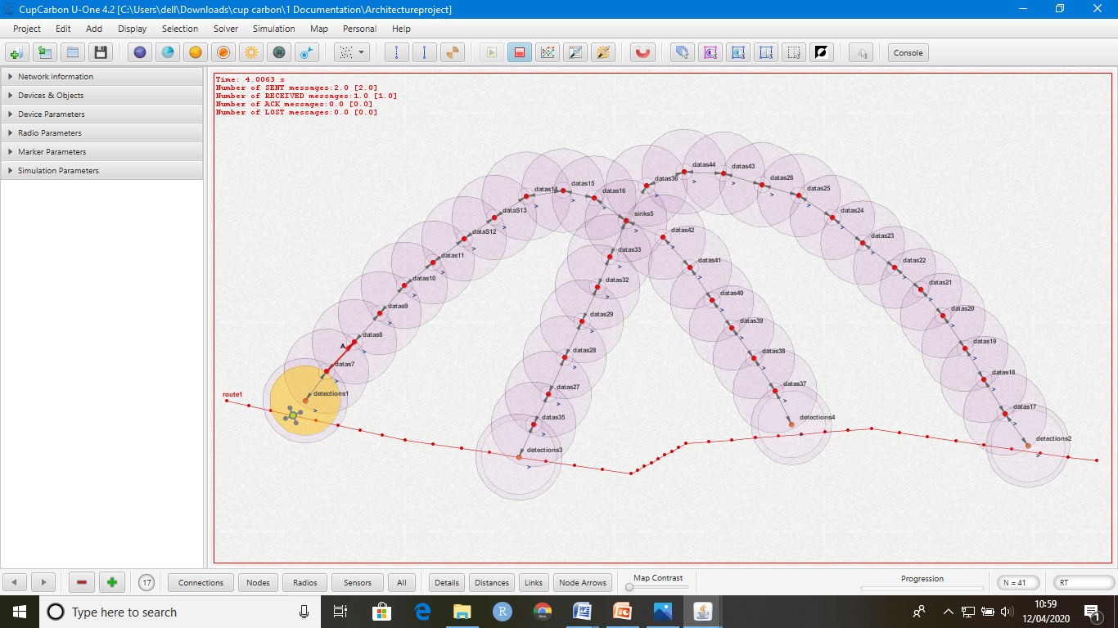
Execution
The Execution of Mobile detection using Cupcarbon simulator. The User Interface of CupCarbon.

Slide 17

Contd…
The Mobile is detected by the sensor nodes and send the data to the Sink node

Slide 18

Contd…

Slide 19
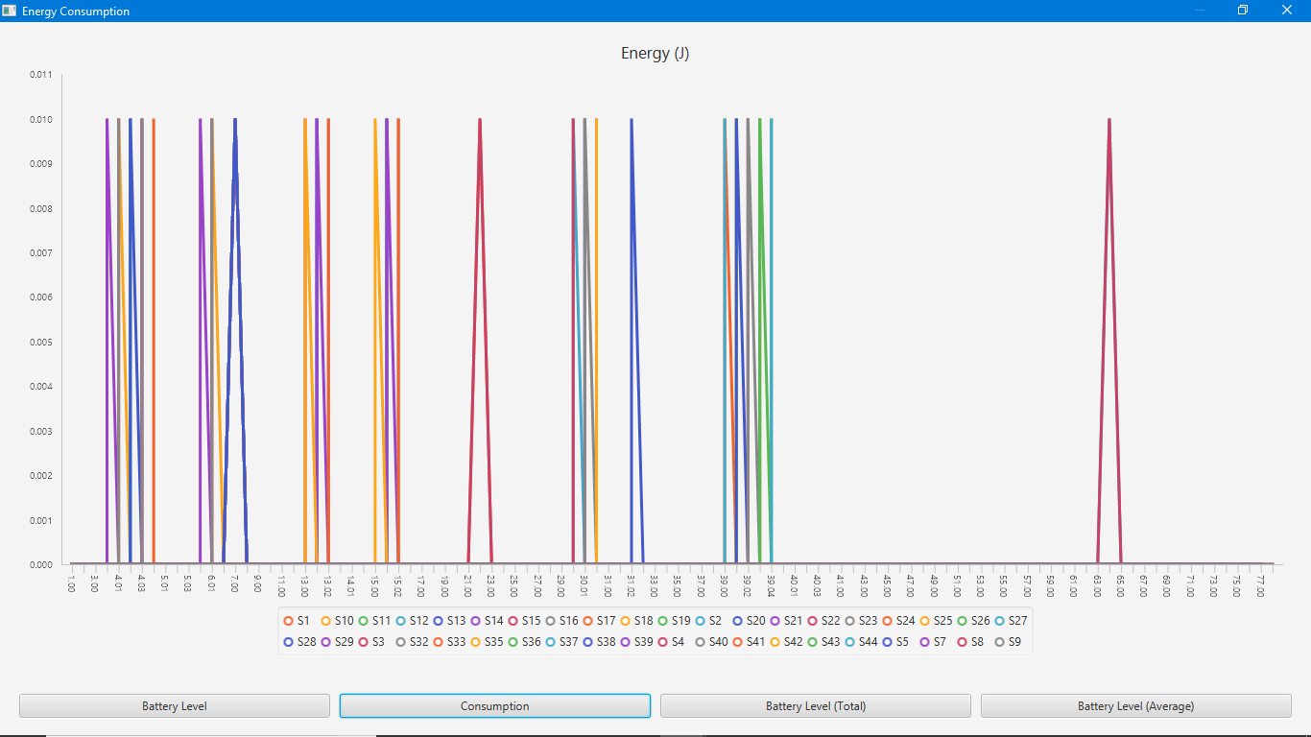
Results
The Results of Energy consumption and Battery Levels
Can be Viewed in Graph viewer. The energy consumption
of all nodes are shown below.

Slide 20
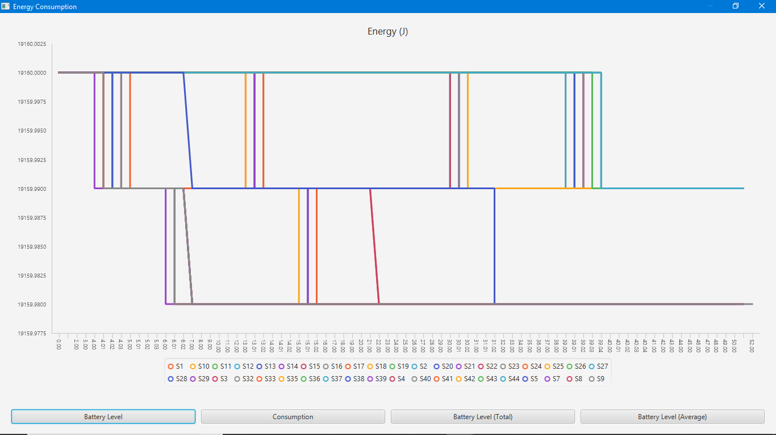
Contd…
The Battery Consumption of all nodes are shown below

Slide 21
Conclusion
From the experiments, the result that has been concluded
is that the Energy Consumption has been reduced by 0.9%
and Lifetime of a Sensor is significantly Increased by 20%
When compared to other WSN simulators . The results
obtained thus conclude that CupCarbon shows the less
energy consumption and long lifetime of a sensor node in
the network.

Slide 22
References
[1] Network Protocols and Algorithms ISSN 1943-3581 2018, Vol. 10, No. 2 –”Evaluation of CupCarbon Network Simulator for Wireless Sensor Networks “
[2] International Journal of Science, Engineering and Technology Research (IJSETR) Volume 6, Issue 4, April 2017, ISSN: 2278 -7798 –”PRESENCE OF ACTIVE MOBILE PHONES AND HIDDEN CAMERA DETECTION K.Parvateesam , G.A. ArunKumar”
[3] Massinissa Saoudi, Ahc`ene Bounceur, Reinhardt Euler, Tahar Kechadi, Alfredo Cuzzocrea –” Intelligent Data Mining Techniques for Emergency Detection in Wireless Sensor Networks”

Slide 23
Thank you
Queries
?

